Slide 1
Optimizing for Speed: Advanced JS/CSS Management in DNN 6.1
Ian Robinson
10/24/2011

Slide 2
Why We’re Here
Performance is a feature (an important one)
Fast sites lead to satisfied users
DotNetNuke is largely optimized on the server side, was not so much on the client side

Slide 3
Meeting Goals
You should understand
The client resource management “problem domain”
What the ClientDependency Framework is and how to use it
The details of the solution in DNN 6.1
The development strategies the new API enables

Slide 4
Client Side Performance
80% of the end-user response time is spent on the front-end. Most of this time is tied up in downloading all the components in the page: images, stylesheets, scripts, Flash, etc. Reducing the number of components in turn reduces the number of HTTP requests required to render the page. This is the key to faster pages.
-Yahoo! Exceptional Performance Team

Slide 5
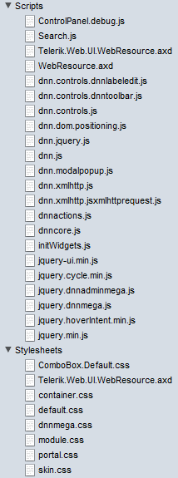
DotNetNuke 6 – Resources Overview
Clean install, home page
unauthenticated
6 CSS Files
13 JavaScript Files
Logged in as host
8 CSS Files
22 JavaScript Files

Slide 6
Goals for Improvement
Reduce the file size of each resource
Only deliver a resource that is needed
Combine resources into as few as possible

Slide 7
Client Resource Management: Key Characteristics
Resource Registration API
Request a JS or CSS resource be loaded
File combination
Combine all requests of a given type into one file
Caching / Persistence
Cache the combined file / save it to disk
Reuse
Reuse cached files across pages if appropriate
Versioning
Allow for cache busting based on versioning

Slide 8
Client Dependency Framework
Open Source Framework
Microsoft Public License (Ms-PL)
Originally released Early 2010
Supports MVC & WebForms
Used in Umbraco
Meets all key characteristics on the previous slide

Slide 9
JavaScript and CSS Registration

Slide 10
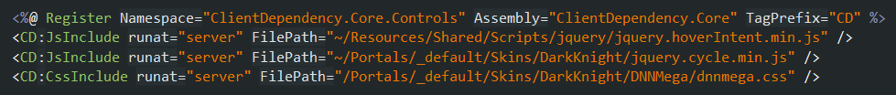
Step 1: Resource Registration
Script Loader on page
Register in code
Or register in markup

Slide 11
Resource Registration w/ DNN API
Wrapped script loader control in Default.aspx
Register in code using DNN API
Or register in markup using wrapped controls

Slide 12
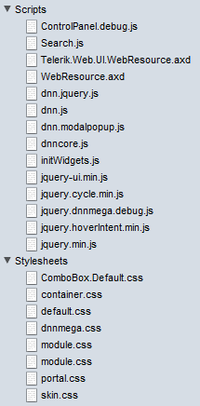
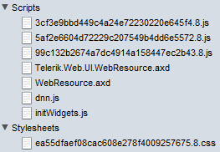
DNN 6.1 w/ Client Dependency
debug=“true”
Home page, clean install
Unauthenticated
Debug
8 CSS Files
14 JS Files
22 Total
Release
1 CSS Files
7 JS Files
8 Total
14 Fewer Requests
debug=“false”

Slide 13
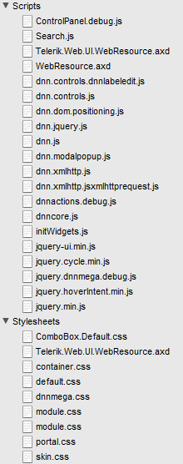
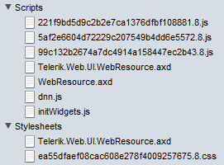
DNN 6.1 w/ Client Dependency
debug=“true”
debug=“false”
Home page, clean install
Logged in as Host
Debug
9 CSS Files
20 JS Files
29 Total
Release
2 CSS Files
7 JS Files
9 Total
20 Fewer Requests

Slide 14
Into the wild
DNN Core Strength: custom & third party components
But, usage means resource requests often grow
Consider these (unauthenticated. As of 8/16/2011)
R2integrated.com: 30+ JS files and 5 CSS files
DataSprings.com: 18 JS files and 11 CSS files
DotNetNuke.com: 16 JS files and 12 CSS files
EngageSoftware.com: 23 JS files and 9 CSS files
Mybrantford.ca: 17 JS files and 9 CSS files
Dreamslider.net: 16 JS files and 9 CSS files

Slide 15
A New Development Approach

Slide 16
Step 2: A New Development Approach
Freed up to structure as necessary
No longer shove all styles into one module.css file
Can break it out into separate files and request as needed
CssInclude(‘base.css’)
CssInclude(‘ui-widgets.css’)
CssInclude(‘gallery.css’)
Same with JS files

Slide 17
Implementation
Details

Slide 18
Implementation Details
Reference Assembly
Additional web.config section
Composite files stored in App_Data/ClientDependency
DNN wrapper API methods
RegisterStyleSheet already exists
RegisterScript?
Wrapper control for user in skins and other controls
WebUtility and WebControls assemblies need updating
CDN integration
Load ordering scheme for both JS & CSS

Slide 19
The New API
DotNetNuke.Web.Client Assembly
RegisterStyleSheet methods
RegisterScript methods
DnnCssInclude
DnnJsInclude

Slide 20
File Combination
Duplicates removed based on path/filename
Combined into one file
Absolute external URLS (JS & CSS) such as CDN requests are requested separately
An xml file map is kept on the server
The dynamic URL is a hash of those file path/names

Slide 21
Location in the Document
Provider model
Provider dictates where it is rendered
Out of the box:
LoaderControlProvider
PageHeaderProvider
LazyLoadProvider
DNN Provides:
DnnBodyRenderProvider
DnnFormBottomRenderProvider

Slide 22
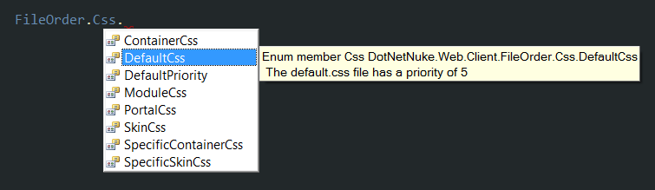
File Ordering
Integer based relative priority
DotNetNuke core file order enumeration (spaced by 5)

Slide 23
Caching and Persistence
ASP.NET Output Caching
MSDN: “On subsequent requests, the page or user control code is not executed; the cached output is used to satisfy the request.”
Stored on disk for persistence across application restarts
Pulled from disk (not rebuilt) and put in cache

Slide 24
Versioning
Integer based version number
Stored in web.config
Forces a fresh rebuild of the files
A variety of ways to increment
Install an extension
Clear the cache
Save Portal.css
Perform an upgrade

